Slide 1

About the Presentations
The presentations cover the objectives found in the opening of each chapter.
All chapter objectives are listed in the beginning of each presentation.
You may customize the presentations to fit your class needs.
Some figures from the chapters are included. A complete set of images from the book can be found on the Instructor Resources disc.

Slide 2
Guide to Networking Essentials,
6th Edition
Chapter 1: Introduction to Computer Networks

Slide 3
Objectives
Describe basic computer components and operations
Explain the fundamentals of network communication
Define common networking terms
Compare different network models
Identify the functions of various network server types
Describe specialized networks
Copyright © 2012 Cengage Learning. All rights reserved.

Slide 4
An Overview of Computer Concepts
Most of the devices you encounter when working with a network involve a computer
Most obvious devices are workstations and network servers
  These run operating systems such as Windows, Linux, UNIX, and Mac OS
Also includes routers and switches
  These are specialized computers used to move data from computer to computer and network to network
  You will learn more about them in later chapters
Copyright © 2012 Cengage Learning. All rights reserved.

Slide 5
Basic Functions of a Computer
Computer’s functions can be broken down into three basic tasks:
  Input: A user running a word-processing program types the letter “A” on the keyboard, which results in sending a code representing the letter “A” to the computer
  Processing: The computer’s central processing unit (CPU) determines what letter was typed by looking up the keyboard code in a table.
  Output: The CPU sends instructions to the graphics cards to display the letter “A”, which is then sent to the computer monitor.
Copyright © 2012 Cengage Learning. All rights reserved.

Slide 6
Input Components
Common user-controlled devices such as keyboards, mice, microphones, Web cameras, and scanners
External interfaces, such as serial, FireWire, and USB ports can also be used to get input from peripheral devices
Storage devices such as hard disks and CDs/DVDs
Copyright © 2012 Cengage Learning. All rights reserved.

Slide 7
Processing Components
A computer’s main processing component is the CPU
  Executes instructions from computer programs such as word processors and from the computer’s operating system
  Current CPUs are composed of two or more processors called cores
A graphics processing unit (GPU) takes a high-level graphics instruction and performs the calculation needed for the instruction to be displayed on the monitor
Other devices, such as network interface cards and disk controller cards, might also include onboard processors
Copyright © 2012 Cengage Learning. All rights reserved.

Slide 8
Output Components
Most obvious are monitors and printers
Also includes storage devices, network cards, and speakers
External interfaces
  For example, a disk drive connected to a USB port allows reading files from the disk (input) and writing files to the disk (output).
Copyright © 2012 Cengage Learning. All rights reserved.

Slide 9
Storage Components
The more storage a computer has, the better
Most storage components are both input and output devices
Most people think of storage as disk drives, CD/DVD drives, and USB flash drives
However, there are two main categories of storage
  Short-term storage
  Long-term storage
Copyright © 2012 Cengage Learning. All rights reserved.

Slide 10
RAM: Short-Term Storage
Random Access Memory (RAM) – when power to the computer is turned off, RAM’s contents are gone
The amount of RAM in a computer is crucial to the computer’s capability to operate efficiently
RAM is also referred to as working storage
If there’s not enough RAM to run a program, the computer will use the disk drive to supplement
Copyright © 2012 Cengage Learning. All rights reserved.

Slide 11
Long-Term Storage
Maintains its data even when there’s no power
Examples:
  Hard disks
  CDs/DVDs
  USB flash drives
Used to store document and multimedia files
Amount of storage a computer needs depends on the type and quantity of files to be stored
Copyright © 2012 Cengage Learning. All rights reserved.

Slide 12
Data is Stored in Bits
Data on a computer is stored as binary digits (“bits” for short)
A bit holds a 1 or 0 value
A pulse of 5 volts of electricity can represent a 1 bit and a pulse of 0 volts can represent a 0 bit
With fiber-optic cable, a 1 bit is represented by the presence of light and a 0 bit by the absence of light
A “byte” is a collection of 8 bits
Copyright © 2012 Cengage Learning. All rights reserved.

Slide 13
Personal Computer Hardware
Four major PC components:
  Motherboard
  Hard drive
  RAM
  BIOS/CMOS (basic input/output system) is the program a personalcomputer's microprocessor uses to get the computer system started after you turn it on. It also manages data flow between the computer'soperating system and attached devices such as the hard disk, video adapter, keyboard, mouse and printer.
Copyright © 2012 Cengage Learning. All rights reserved.

Slide 14
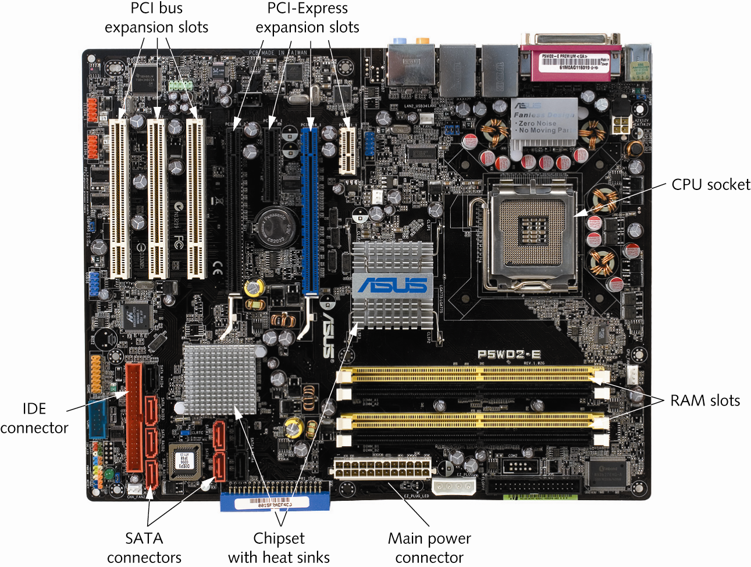
Motherboard
Chipset manages the data flow between the processor, memory and peripherals.
Copyright © 2012 Cengage Learning. All rights reserved.

Slide 15
Computer Bus Fundamentals
Bus: a collection of wires carrying data from one place to another on the computer
All data that goes into or comes out of a computer goes through the motherboard
There are buses between:
  CPU and RAM
  CPU and disk drives
  CPU and expansion slots
Copyright © 2012 Cengage Learning. All rights reserved.

Slide 16
Hard Drive Fundamentals
Hard drive: primary long-term storage component on your computer
Consists of magnetic disks called platters that store data in the form of magnetic pulses
Stores the OS your computer loads when it boots
Stores the documents you use as well as the applications that open those documents
Copyright © 2012 Cengage Learning. All rights reserved.

Slide 17
RAM Fundamentals
RAM is the main short-term storage component on your computer
RAM has no moving parts so accessing data in RAM is much faster than accessing data on a hard drive
In general, the more RAM your system has, the faster it will run
Copyright © 2012 Cengage Learning. All rights reserved.

Slide 18
BIOS/CMOS Fundamentals
BIOS: basic input/output system
  Set of instructions located in a chip on the motherboard
  Those instructions tell the CPU to perform certain tasks when power is first applied to the computer
  One of those instructions is to perform a power-on self test (POST)
When a computer boots, the BIOS program offers a chance to run the Setup program in order to configure hardware components
  This configuration is stored in a type of memory called complementary metal oxide semiconductor (CMOS)
Copyright © 2012 Cengage Learning. All rights reserved.

Slide 19
Computer Boot Procedure
Power is applied to the motherboard.
The CPU starts.
The CPU carries out the BIOS startup routines, including the POST.
Boot devices, as specified in the BIOS configuration, are searched for an OS.
The OS is loaded into RAM.
OS services are started.
Copyright © 2012 Cengage Learning. All rights reserved.

Slide 20
How the Operating System and Hardware Work Together
A computer’s OS provides many critical services:
  a user interface
  memory management
  a file system
  multitasking
  the interface to a computer’s hardware devices
Without an OS, each application would have to provide the above services
Copyright © 2012 Cengage Learning. All rights reserved.

Slide 21
User Interface
Enables people to interact with computers
Graphical user interfaces (GUIs) allow users to point and click to run applications and access services
Without a user interface, a computer could process only information that has been programmed into memory
Copyright © 2012 Cengage Learning. All rights reserved.

Slide 22
Memory Management
When the OS loads an application, memory must be allocated for the application to run in
When the application exits, the memory it was using must be marked as available
This memory management is performed by the OS
Copyright © 2012 Cengage Learning. All rights reserved.

Slide 23
File System
File system is used to organize space on storage devices
Objectives of contemporary file systems:
  Provide a convenient interface for users and applications to open and save files
  Provide an efficient method to organize space on a drive
  Provide a hierarchical filing method to store files
  Provide an indexing system for fast retrieval of files
  Provide secure access to files by authorized users
Copyright © 2012 Cengage Learning. All rights reserved.

Slide 24
Multitasking
Multitasking is an OS’s capability to run more than one application or process at the same time
The OS is designed to look for applications that have work to do and then schedule CPU time so that the work gets done
Copyright © 2012 Cengage Learning. All rights reserved.

Slide 25
Interface to Hardware Devices
When an application needs to communicate with computer hardware, it calls on the OS, which then calls on a device driver
A device driver is software that provides the interface between the OS and computer hardware
Every device performing an input or output function requires a device driver
Copyright © 2012 Cengage Learning. All rights reserved.

Slide 26
Fundamentals of Network Communication
A computer network consists of two or more computers connected by some kind of transmission medium, such as a cable or air waves.
In order to access the Internet, a computer has to be able to connect to a network
The next few slides will cover what is required to turn a standalone computer into a networked computer
Copyright © 2012 Cengage Learning. All rights reserved.

Slide 27
Network Components
Hardware components
  Network interface card—A NIC is an add-on card that's plugged into a motherboard expansion slot and provides a connection between the computer and the network.
  Network medium—A cable that plugs into the NIC and makes the connection between a computer and the rest of the network. Network media can also be the air waves, as in wireless networks.
  Interconnecting—Interconnecting devices allow two or more computers to communicate on the network without having to be connected directly to one another.
Copyright © 2012 Cengage Learning. All rights reserved.

Slide 28
Network medium
Air waves: in wireless networks.
Twisted-pair cables:
Used for telephone communications and most modern Ethernet networks
Guide to Networking Essentials, 6th ed.

Slide 29
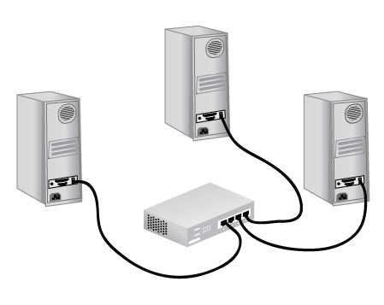
A typical network
Copyright © 2012 Cengage Learning. All rights reserved.

Slide 30
Network Components
Software Components
  Network clients and servers—Network client software requests information that's stored on another network computer or device. Network server software allows a computer to share its resources by fielding resource requests generated by network clients.
  Protocols—Network protocols define the rules and formats a computer must use when sending information across the network. Think of it as a language that all devices on a network understand.
  NIC drivers—NIC drivers receive data from protocols and then forward this data to the physical NIC, which transmits data onto the medium.
Copyright © 2012 Cengage Learning. All rights reserved.

Slide 31
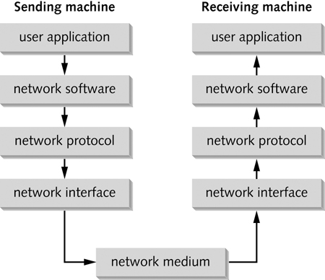
Layers of the Network Communication Process
Each step required for a client to access network resources is referred to as a “layer”
Each layer has a task and all layers work together
Simulation 1 – Layers of the network communication process
Copyright © 2012 Cengage Learning. All rights reserved.

Slide 32
Layers of the Network Communication Process
of the network communication process
Step | Description | Layer
1 | An application tries to access a network resource. | User application
2 | Client software detects the attempt to access the network and passes the message on to the network protocol. | Network software
3 | The protocol packages the message in a format suitable for the network and sends it to the NIC driver. | Network protocol
4 | The NIC driver sends the data in the request to the NIC card, which converts it into the necessary signals to be transmitted across the network medium. | Network interface
Copyright © 2012 Cengage Learning. All rights reserved.

Slide 33
How Two Computers Communicate
TCP/IP is the most common protocol (language) used on networks
TCP/IP uses 2 addresses to identify devices on a network
  Logical address (called IP address) Unique on the web
  Physical address (called MAC address)
Just as a mail carrier needs an address to deliver mail, TCP/IP needs an address in order to deliver data to the correct device on a network
Think of the Logical address as a zip code and the Physical address as a street address
Copyright © 2012 Cengage Learning. All rights reserved.

Slide 34
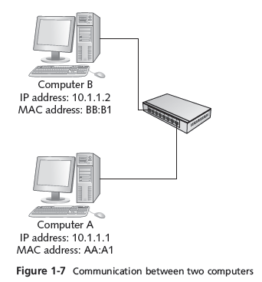
Communication Between Two Computers
A user at Comp A types ping 10.1.1.2 at a command prompt
The network software creates a ping message
The network protocol packages the message by adding IP address of sending and destination computers and acquires the destination computer’s MAC address
The network interface software adds MAC addresses of sending and destination computers and sends the message
Comp B receives message, verifies that the addresses are correct and then sends a reply to Comp A using Steps 2 – 4
Simulation 2 – Communication between two computers
Copyright © 2012 Cengage Learning. All rights reserved.

Slide 35
Network Terms Explained
Every profession has its own language and acronyms
Need to know the language of networks to be able to study them
Copyright © 2012 Cengage Learning. All rights reserved.

Slide 36
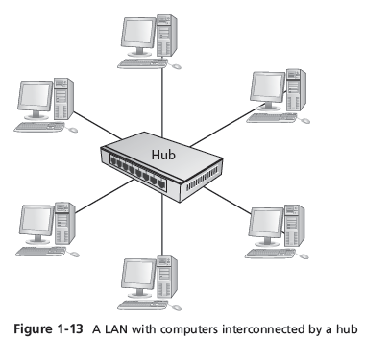
LANs, Internetworks, WANs, and MANs
Local area network (LAN) – small network, limited to a single collection of machines and connected by one or more interconnecting devices in a small geographic area
Copyright © 2012 Cengage Learning. All rights reserved.

Slide 37
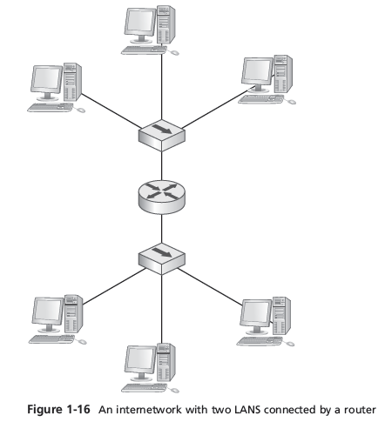
LANs, Internetworks, WANs, and MANs
An internetwork is a networked collection of LANs tied together by devices such as routers
Reasons for creation:
  Two or more groups of users and their computers need to be logically separated but still need to communicate
  Number of computers in a single LAN has grown and is no longer efficient
  The distance between two groups of computers exceeds the capabilities of most LAN devices
Copyright © 2012 Cengage Learning. All rights reserved.

Slide 38
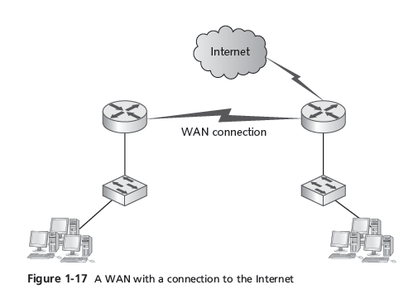
LANs, Internetworks, WANs, and MANs
Wide area networks (WANs) use the services of third-party communication providers to carry network traffic from one location to another
Metropolitan area networks (MANs) use WAN technologies to interconnect LANs in a specific geographic region, such as a county or city
Copyright © 2012 Cengage Learning. All rights reserved.

Slide 39
Packets and Frames
Computers transfer information across networks in shorts bursts of about 1500 bytes of data
Data is transferred in this way for a number of reasons:
  The pause between bursts might be necessary to allow other computers to transfer data during pauses
  The pause allows the receiving computer to process received data, such as writing it to disk
  The pause allows the receiving computer to receive data from other computers at the same time
  The pause gives the sending computer an opportunity to receive data from other computers and to perform other processing tasks
  If an error occurs during transmission of a large file, only the chunks of data involved in the error have to be sent again, not the entire file
Copyright © 2012 Cengage Learning. All rights reserved.

Slide 40
Packets
Chunks of data sent across the network are usually called packets or frames, with packets being the more well-known term
Packet is a chunk of data with source and destination IP address added to it
Using the U.S. mail analogy, you can look at a packet as an envelope that has had the zip code added to the address but not the street address
Copyright © 2012 Cengage Learning. All rights reserved.

Slide 41
Frames
A frame is a packet with the source and destination MAC addresses added to it
The packet is “framed” by the MAC addresses on one end and an error-checking code on the other
A frame is like a letter that has been addressed and stamped and is ready to go
The process of adding IP addresses and MAC addresses to chunks of data is called encapsulation
Information added to the front of the data is called a header and information added to the end is called a trailer
Copyright © 2012 Cengage Learning. All rights reserved.

Slide 42
Clients and Servers
A client can be a workstation running a client OS or it can also refer to the network software on a computer that requests network resources from a server
The word “client” is usually used in these three contexts:
  Client operating system: The OS installed on a computer
  Client computer: Primary role is to run user applications and access network resources
  Client software: The software that requests network resources from server software running on another computer
Copyright © 2012 Cengage Learning. All rights reserved.

Slide 43
Clients and Servers
A computer becomes a server when software is installed on it that provides a network service to client computers
The term “server” is also used in three contexts:
  Server operating system: When the OS installed on a computer is designed mainly to share network resources and provide other network services
  Server computer: When a computer’s primary role in the network is to give client computers access to network resources and services
  Server software: Responds to requests for network resources from client software running on another computer
Copyright © 2012 Cengage Learning. All rights reserved.

Slide 44
Network Models
A network model defines how and where resources are shared and how access to these resources is regulated
Fall into two major types
  Peer-to-peer network: Most computers function as clients or servers (no centralized control over who has access to network resources)
  Server-based network: Certain computers take on specialized roles and function mainly as servers, and ordinary users’ machines tend to function mainly as clients
Copyright © 2012 Cengage Learning. All rights reserved.

Slide 45
Peer-to-Peer/Workgroup Model
Computers on a peer-to-peer network can take both a client and a server role
Any user can share resources on his/her computer with any other user’s computer
Every user must act as the administrator of his/her computer
  Can give everyone else unlimited access to their resources or grant restricted access to other users
  Usernames and passwords (credentials) are used to control that access
Copyright © 2012 Cengage Learning. All rights reserved.

Slide 46
Peer-to-Peer/Workgroup Model
Problems with Peer-to-peer networks:
  Must remember multiple sets of credentials to access resources spread out over several computers
  Desktop PCs and the OSs installed on them aren’t made to provide network services as efficiently as dedicated network servers
  Data organization: If every machine can be a server, how can users keep track of what information is stored on which machine?
Peer-to-peer networks are well suited for small organizations that have small networks and small operating budgets
Copyright © 2012 Cengage Learning. All rights reserved.

Slide 47
Server/Domain-Based Model
Server-based networks provide centralized control over network resources
Users log on to the network with a single set of credentials maintained by one or more servers running a server OS
In most cases, servers are dedicated to running network services and should not be used to run user applications
Copyright © 2012 Cengage Learning. All rights reserved.

Slide 48
Server/Domain-Based Model
A domain is a collection of users and computers whose accounts are managed by Windows servers called domain controllers
Users and computers in a domain are subject to network access and security policies defined by a network administrator
  The software that manages this security is referred to as a directory service
  On Windows servers, the directory service software is Active Directory
Copyright © 2012 Cengage Learning. All rights reserved.

Slide 49
Server/Domain-Based Model (cont.)
Other network services usually found on network servers:
  Naming services: Translate computer names to their address
  E-mail services: Manage incoming and outgoing email
  Application services: Grant client computers access to complex applications that run on the server
  Communication services: Give remote users access to a network
  Web services: Provide comprehensive Web-based application services
Copyright © 2012 Cengage Learning. All rights reserved.

Slide 50
Server/Domain-Based Model (cont.)
Server-based networks are easier to expand than peer-to-peer
  Peer-to-peer should be limited to 10 or fewer users, but
  server-based networks can handle up to thousands of users
Multiple servers can be configured to work together, which can be used to run a more efficient network or can provide fault tolerance
Peer-to-peer and server-based networks both have advantages so using a combination of the two models isn’t uncommon
Copyright © 2012 Cengage Learning. All rights reserved.

Slide 51
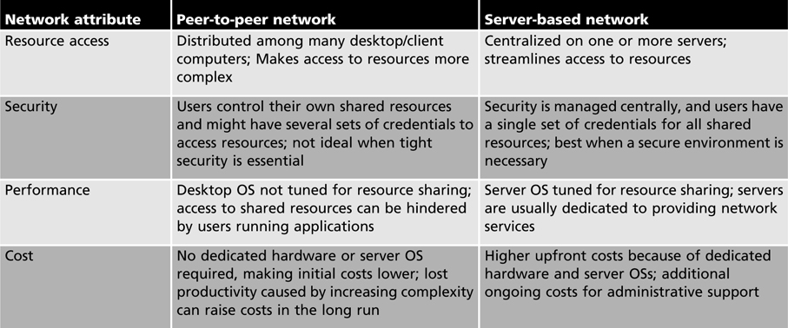
Strengths and Weaknesses of the Two Network Models
peer versus server-based networks
Copyright © 2012 Cengage Learning. All rights reserved.

Slide 52
Network Servers
A server is at the heart of any network that is too large for a peer-to-peer configuration
A single server can be configured to fill a single role or several roles at once
Most common server roles found on networks:
  Domain controller/directory servers
  File and print servers
  Application servers
  Communication servers
  E-mail/fax servers
  Web servers
Copyright © 2012 Cengage Learning. All rights reserved.

Slide 53
Network Servers (cont.)
Domain Controller/Directory Servers
  Directory services make it possible for users to locate, store, and secure information about a network and its resources.
  Windows servers permit combining computers, users, groups, and resources into domains. The server handling the computers and users in a domain is called a domain controller.
File and Print Servers
  Provide secure centralized file storage and sharing and access to networked printers.
  Any Windows or Linux computer can act as a file and print server, however the Server version of Windows provides advanced sharing features.
Copyright © 2012 Cengage Learning. All rights reserved.

Slide 54
Network Servers (cont.)
Application Servers
  Supply the server side of client/server applications to network clients
  Differ from basic file and print servers by providing processing services as well as handling requests for file or print services
Communication Servers
  Provide a mechanism for users to access a network’s resources remotely
  Enable users who are traveling or working at home to dial in to the network via a modem or their existing Internet connection
E-mail/Fax Servers
Copyright © 2012 Cengage Learning. All rights reserved.

Slide 55
Network Servers (cont.)
Web Servers
  Windows Server includes a complete Web server called Internet Information Services (IIS) as well as File Transfer Protocol (FTP)
  Apache Web Server is available as a part of most Linux distributions and remains the most widely used Web server in the world
Other Network Services
  Most networks require additional support services to function efficiently. The most common are Domain Name System (DNS) and Dynamic Host Configuration Protocol (DHCP)
  DNS allows users to access both local and Internet servers by name rather than by address
  DHCP provides automatic addressing for network clients so that network administrators do not have to assign addresses manually
  You will learn more about these services in Chapter 5
Copyright © 2012 Cengage Learning. All rights reserved.

Slide 56
Specialized Networks
Storage area network (SAN) – uses high-speed networking technologies to provide servers with fast access to large amounts of disk storage
Wireless personal area network (WPAN) – short-range networking technology designed to connect personal devices to exchange information
  These devices include cell phones, pagers, personal digital assistants (PDAs), global positioning system (GPS) devices, MP3 players, and even watches
Copyright © 2012 Cengage Learning. All rights reserved.

Slide 57
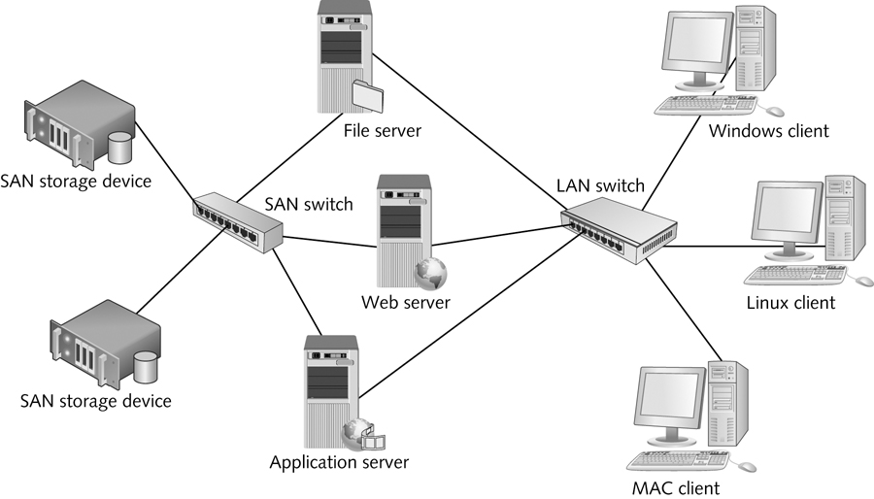
SAN
Copyright © 2012 Cengage Learning. All rights reserved.

Slide 58
Chapter Summary
All computers perform three basic tasks: input, processing, and output
Storage is a major part of a computer’s configuration
Personal computer hardware consists of four major components: motherboard, hard drive, RAM, and BIOS/CMOS
The operating system and device drivers control access to computer hardware and provide a user interface, memory management and multitasking
The components needed to make a stand-alone computer a networked computer include a NIC, network medium, and usually a device to interconnect with other computers
The layers of the network communication process can be summarized as user application, network software, network protocol, and network interface
Copyright © 2012 Cengage Learning. All rights reserved.

Slide 59
Chapter Summary
The four terms used to describe networks of different scope are LAN, Internetwork, WAN, and MAN
Packets and frames are the units of data handled by different network components. Packets have the source and destination IP address added and are processed by the network protocol. Frames have the MAC addresses and an error code added and are processed by the network interface.
A client is the computer or network software that requests network data and a server is the computer or network software that makes the network data available to requesting clients
A peer-to-peer network model has no centralized authority over resources while a server-based network usually uses a directory service to provide centralized resource management
Network servers can perform a number of specialized roles
Specialized networks can include storage area networks (SANs) and wireless personal area networks (WPANs)
Copyright © 2012 Cengage Learning. All rights reserved.

